Slide 1

TOuNN : Topology Optimization using Neural Networks
Aaditya Chandrasekhar
Krishnan Suresh

Slide 2
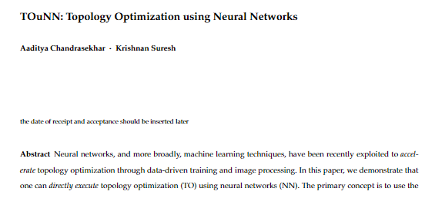
Paper: https://ersl.wisc.edu/publications/2020/TOuNN_Submitted.pdf
Code : https://ersl.wisc.edu/software/TOuNN.zip

Slide 3
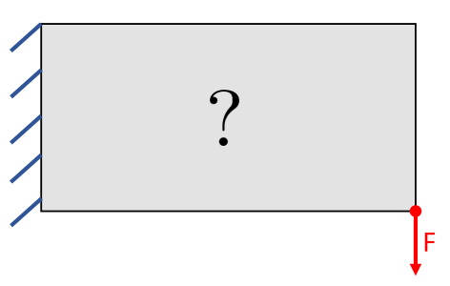
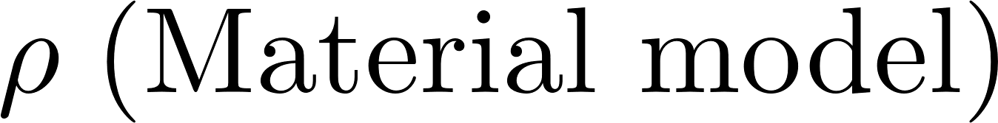

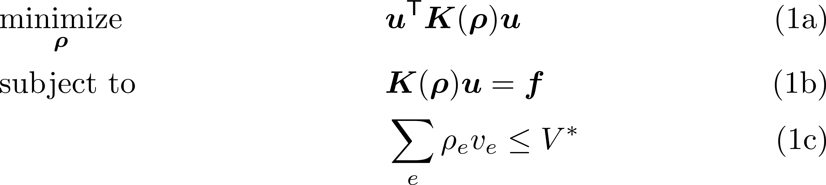
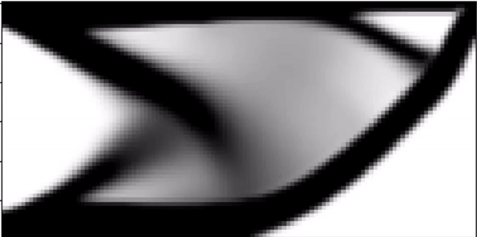
Topology Optimization
{
{
How is material distributed over a given domain ?
Consider classical SIMP TO,
Cantilever Beam
Other approaches :
Level set
IGA
BESO…
SIMP TO
Notes:
Add movie of SIMP. Mention other approaches. Current focus is on SIMP based . Key concept: Mesh -> elem/node based capturing of field. Design variable is different/ capturing rho using NN!

Slide 4
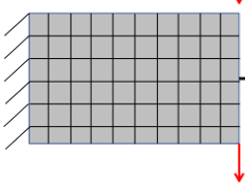
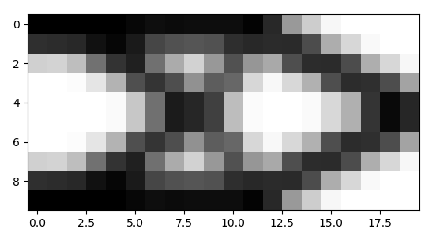
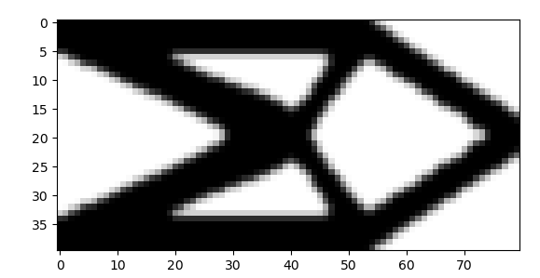
FE based SIMP– Design variable
SIMP : Element/node density
TO depends on mesh discretization
Domain with B.C.
Discretize domain into mesh
20 X 10 mesh
80 X 40 mesh
Notes:
Level set : Phase field from mesh
BESO : Element on/off

Slide 5
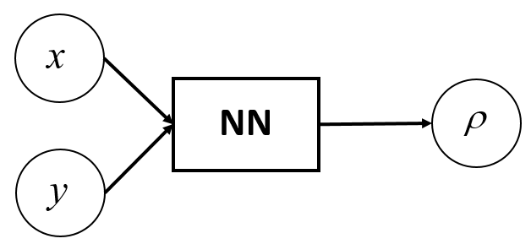

Key concept – TOuNN
{
{
How is material distributed over a given domain ?
NN Output
NN Input
Capture SIMP density using Neural Net
Independent of underlying mesh
Function of spatial coordinate
Global ( weights capture entire design )
Notes:
Change the figure. New slide

Slide 6
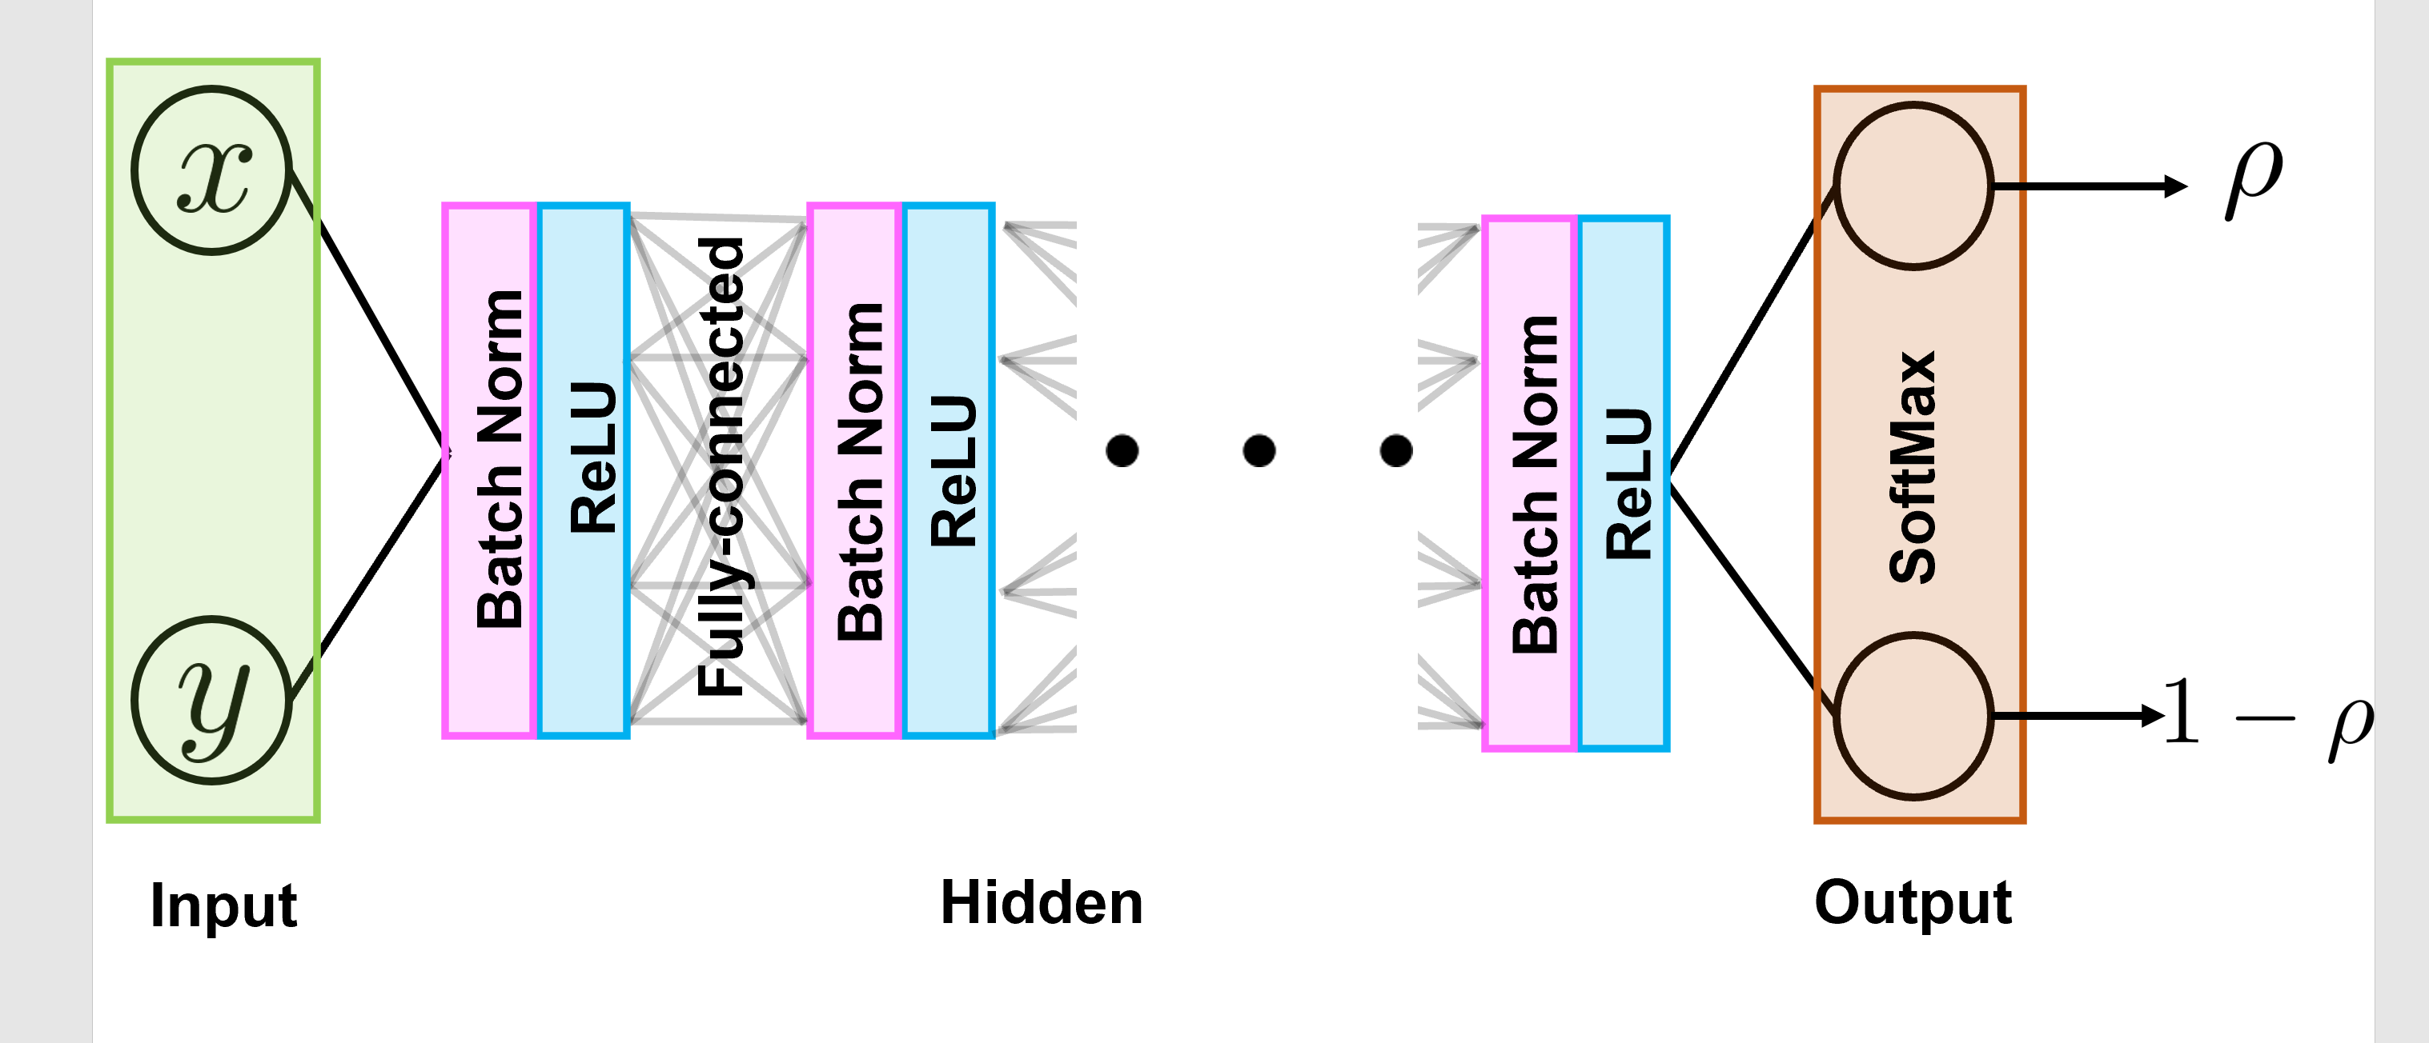

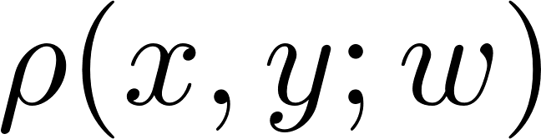
Implementation – Neural net
Fully connected
Batch norm observed to make the optimization more robust (even though full batch used)
Softmax function at output layer.
Notes:
NN has built in optimizer and back prop facility. Comes down to min of loss. Constrained to unconstrained oprtimization bold w. Collection of all design variables.

Slide 7
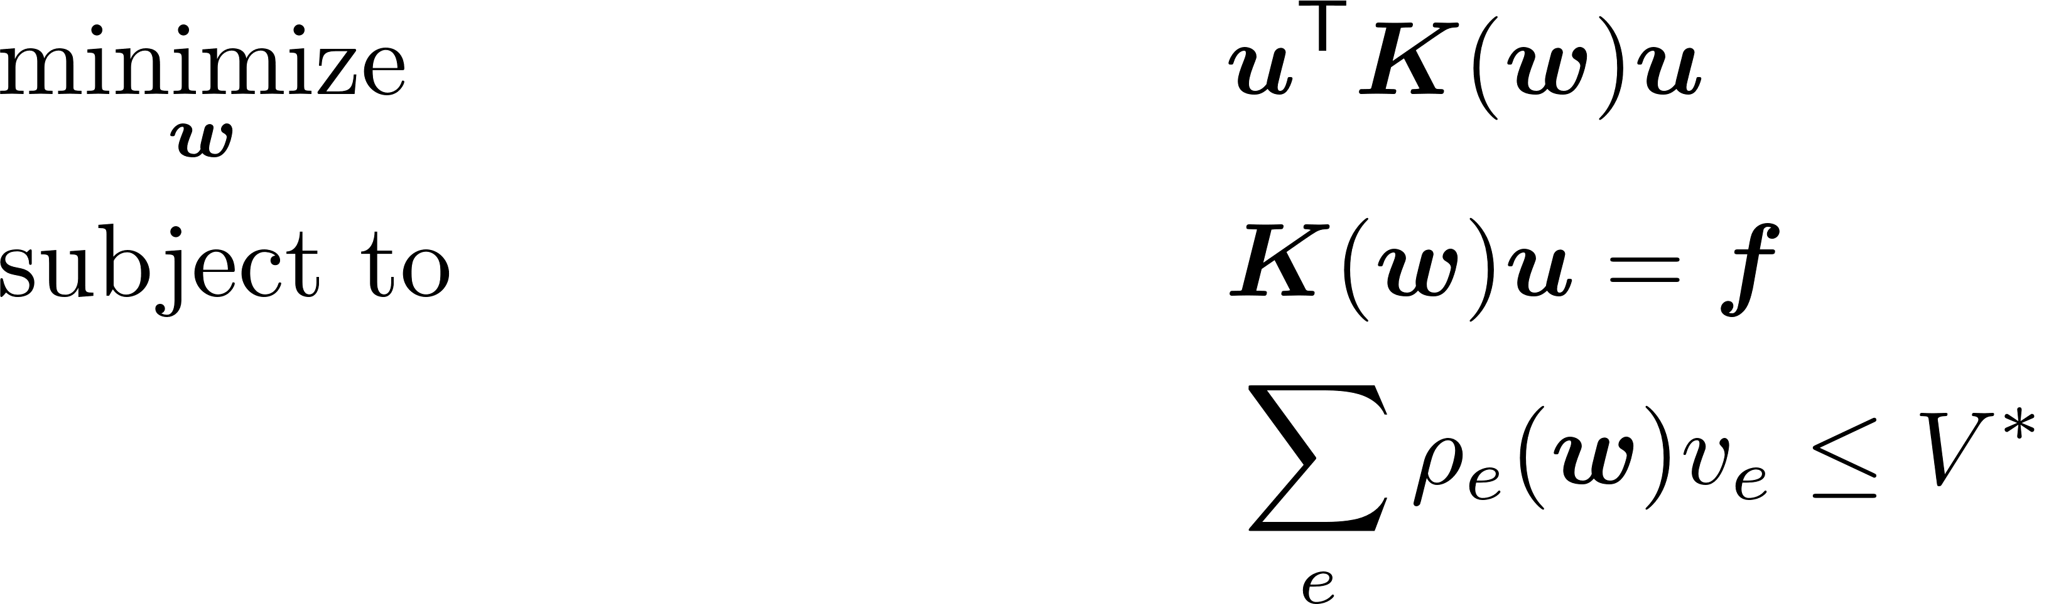
Optimization problem - overview
Notes:
Densities indirectly defined from NN. All design var by w. Here we see constrained problem

Slide 8
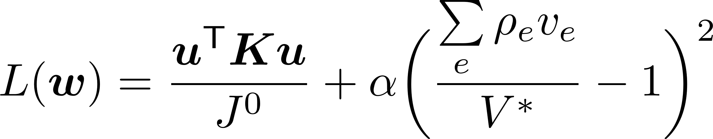
Implementation – Loss
Penalty param
Compliance
Vol constraint
Constrained Optimization Unconstrained Optimization

Slide 9
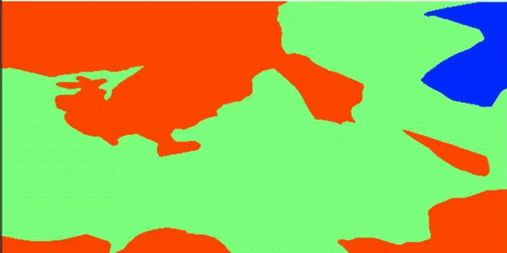
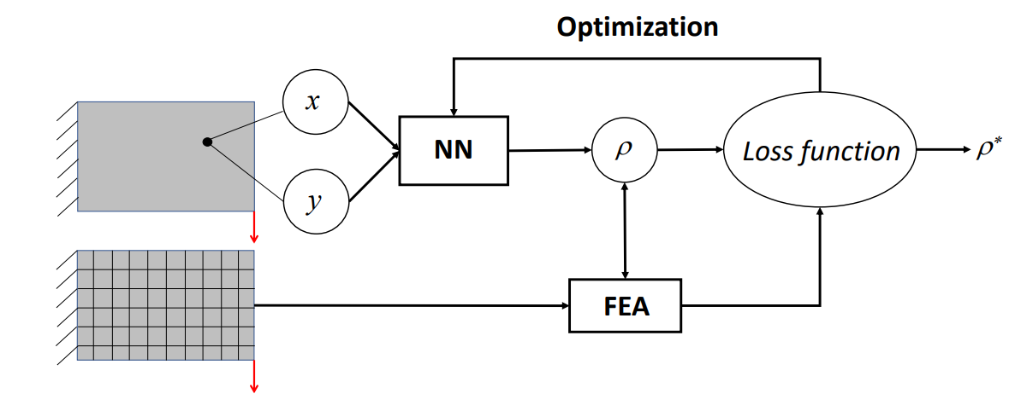
Optimization problem - flowchart
5
1
2
Loss
4
{x,y} from mesh
3
iter
Built in Gradient descent optimizer -Adam
Built in sensitivity calculation – Back propagation
Notes:
Talk about params -> # design variables.

Slide 10
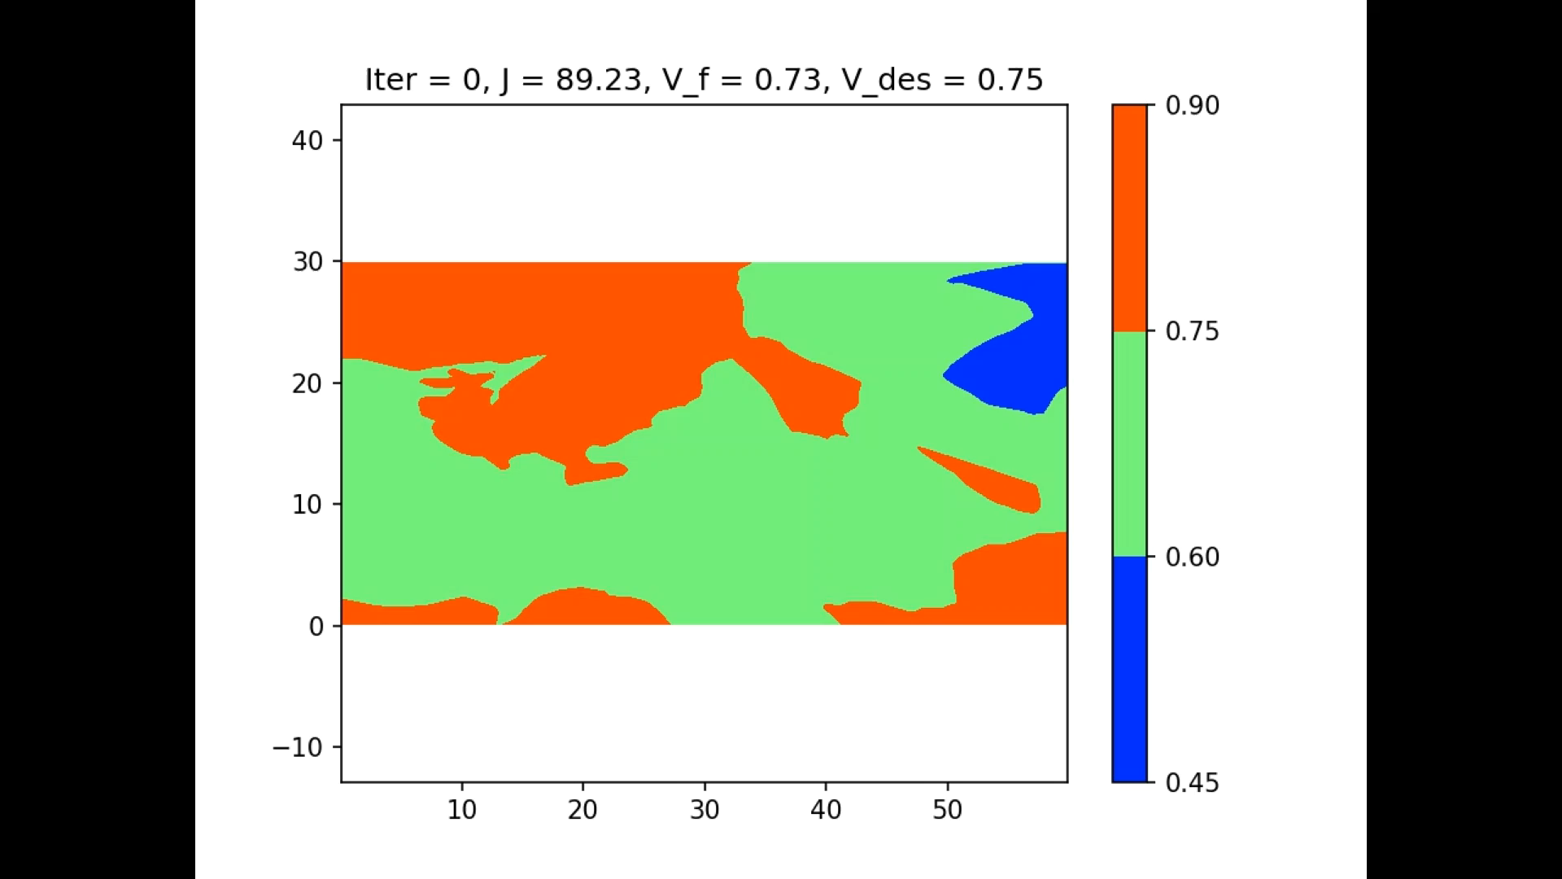
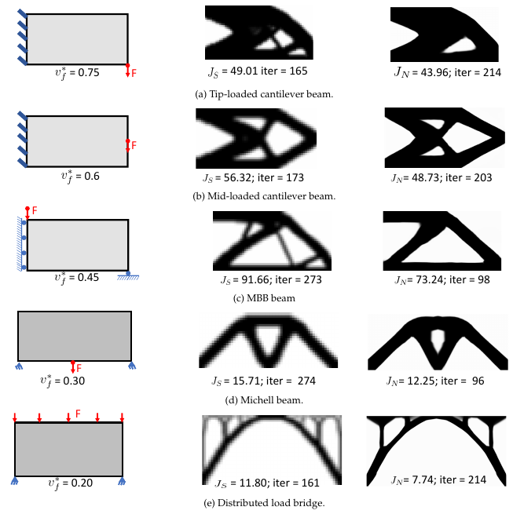
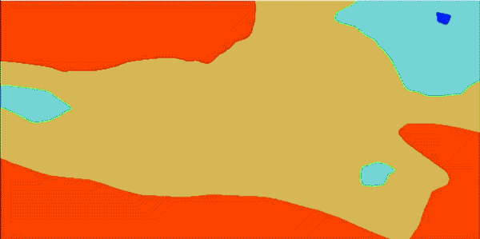
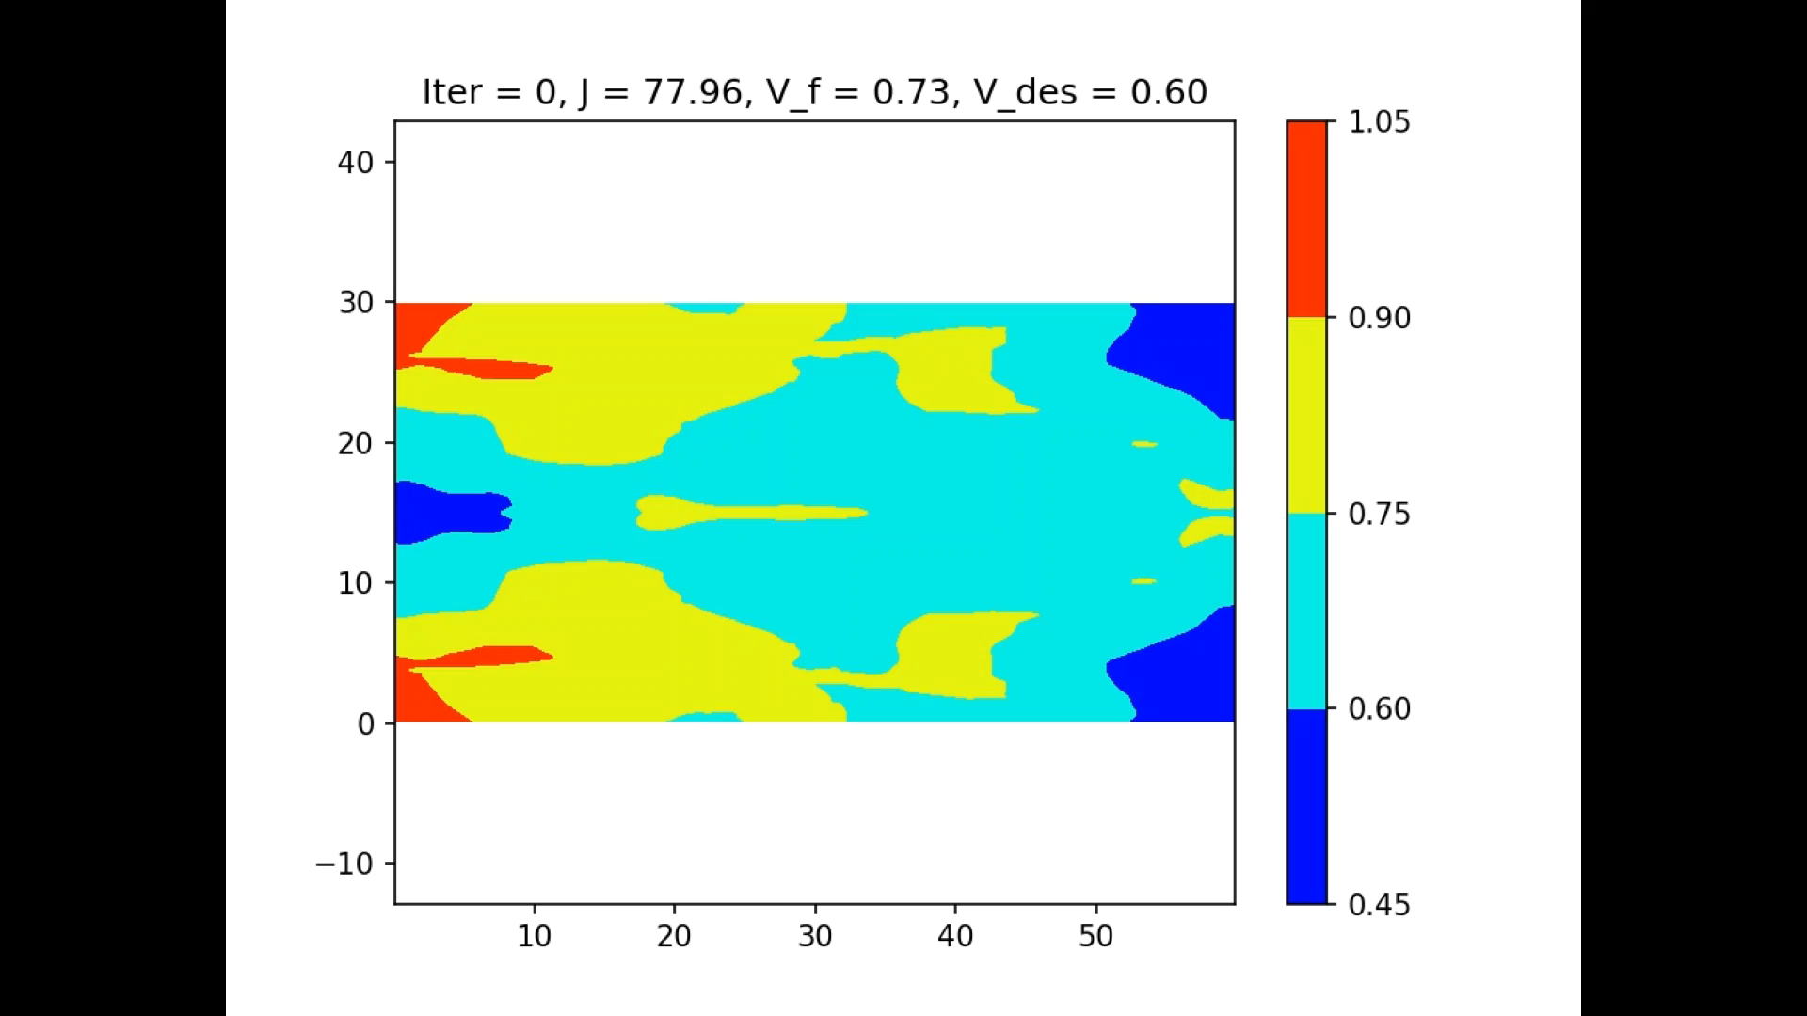
Result – Validation
5 Layers ; 20 Neurons/layer ~ 1700 parms
60 X 30 mesh = 1800 elements/design var.
Problem
SIMP
TOuNN
Notes:
Talk about iteration. Performing better than SIMP. Show as movie, animation. PAUUSE ANIM AFTER OPTIMIZATION

Slide 11
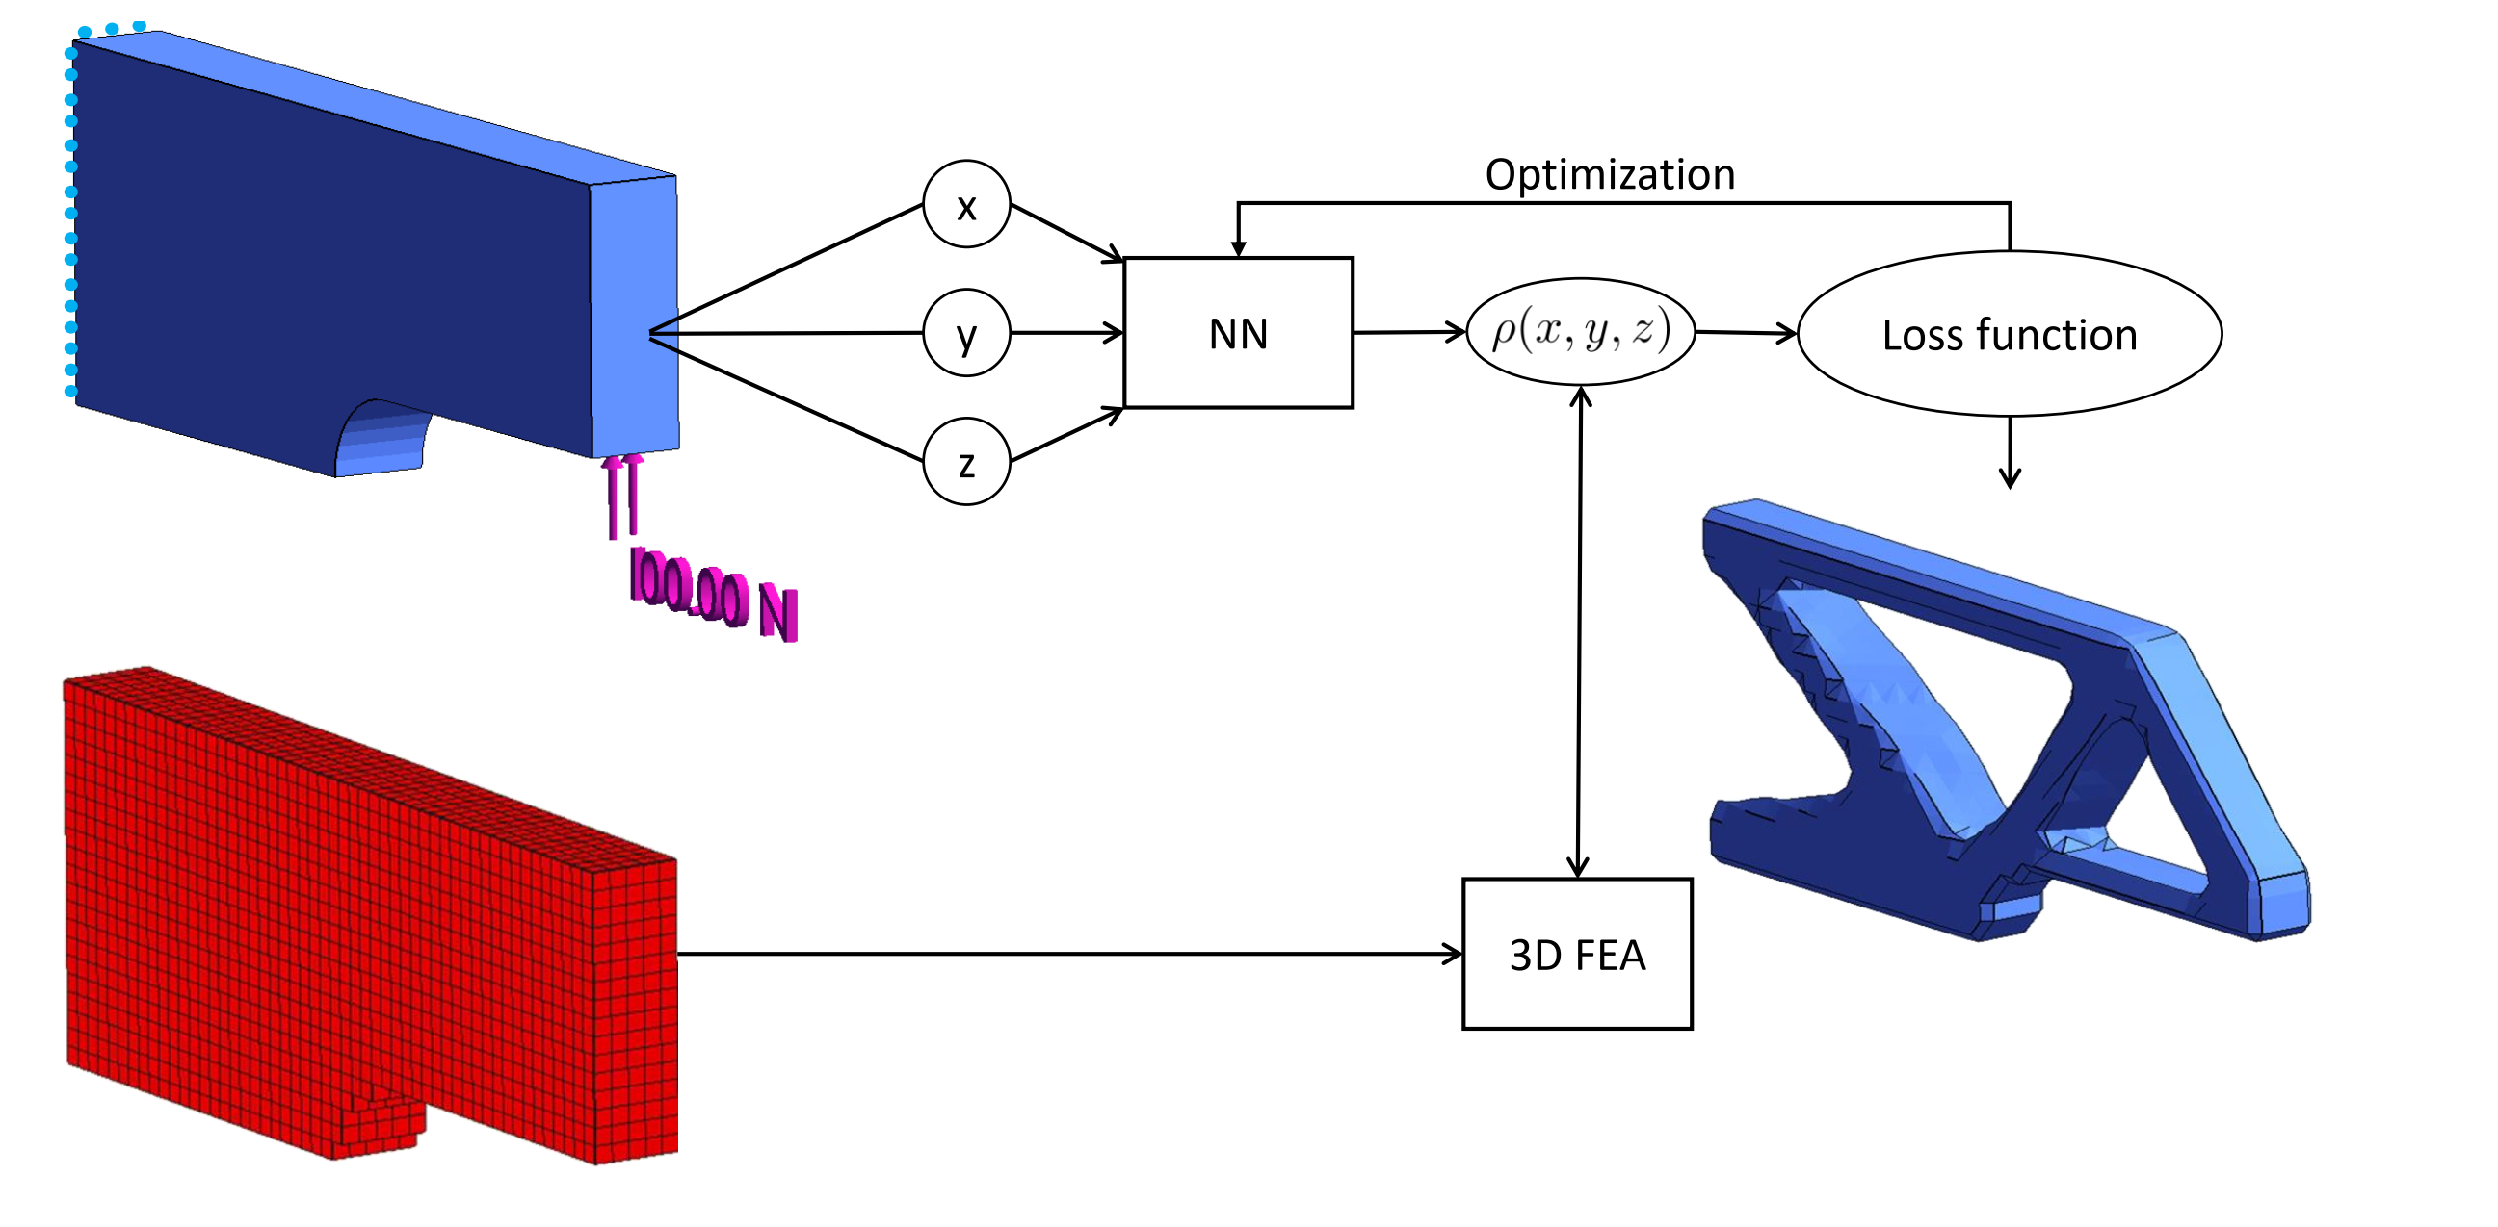
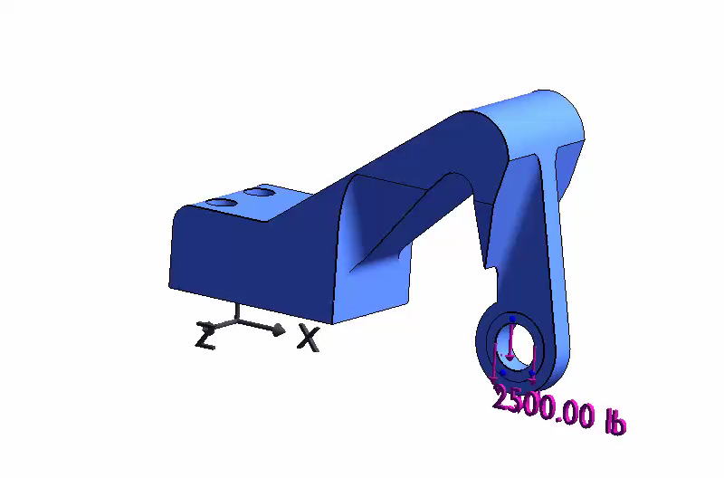
Validation – 3D, non-box geometry

Slide 12
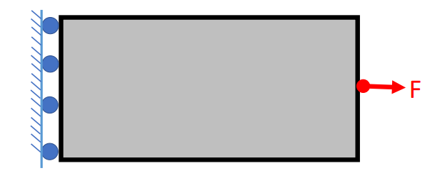
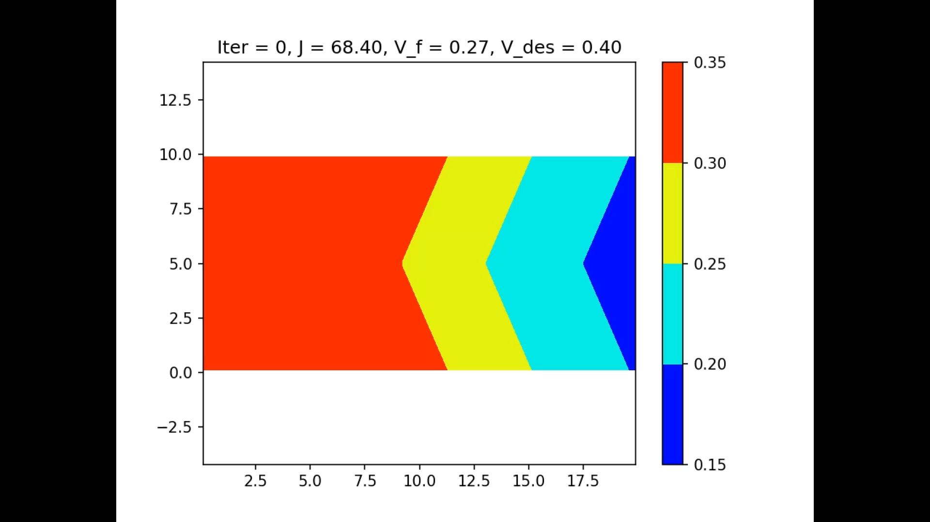
Neural net size ?
NN : 1 X 1 ( 6 parameters)
Captures simple geometry

Slide 13
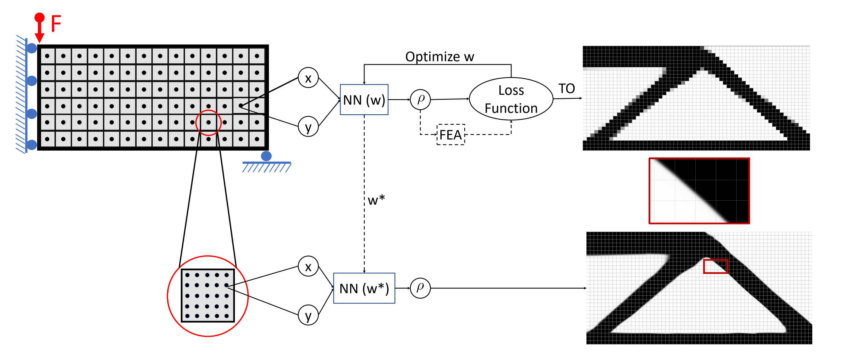
Features – Continuous density function
(Low resolution mesh/sampling)
1
3
4
2
(High resolution mesh/sampling)
Obtain design at high resolution as postprocessing
Notes:
Simplify slide

Slide 14
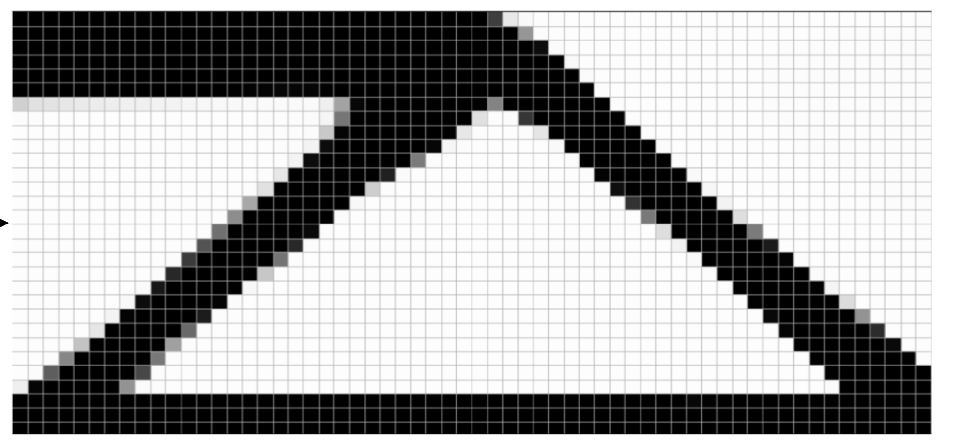
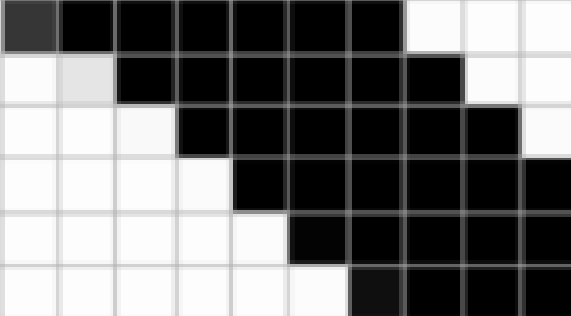
Obtaining boundaries
Staircase boundary
(SIMP)

Slide 15
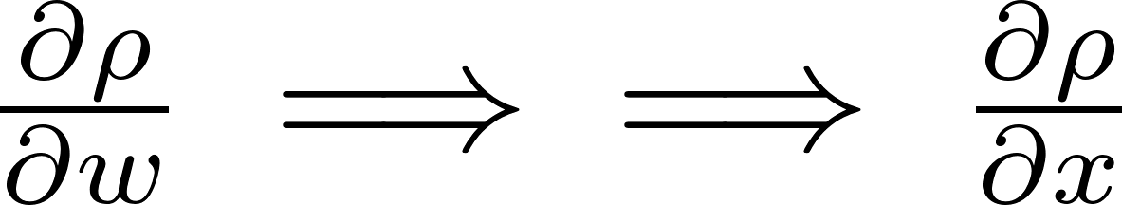
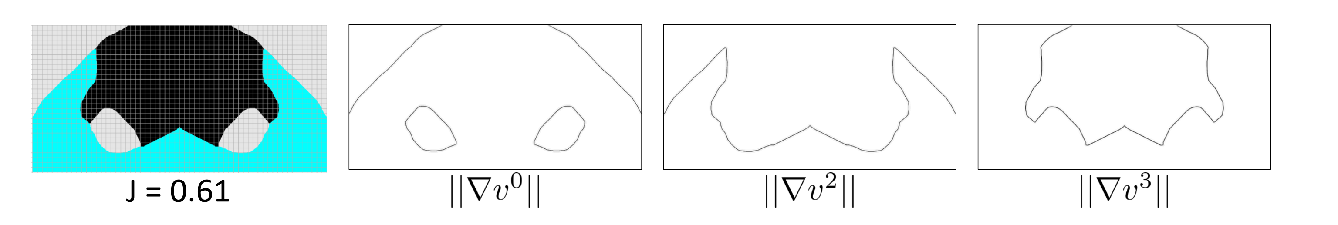
Obtaining boundaries - Backprop

Slide 16
Extensions under consideration
Multi-material
Continuous fiber
Microstructure

Slide 17
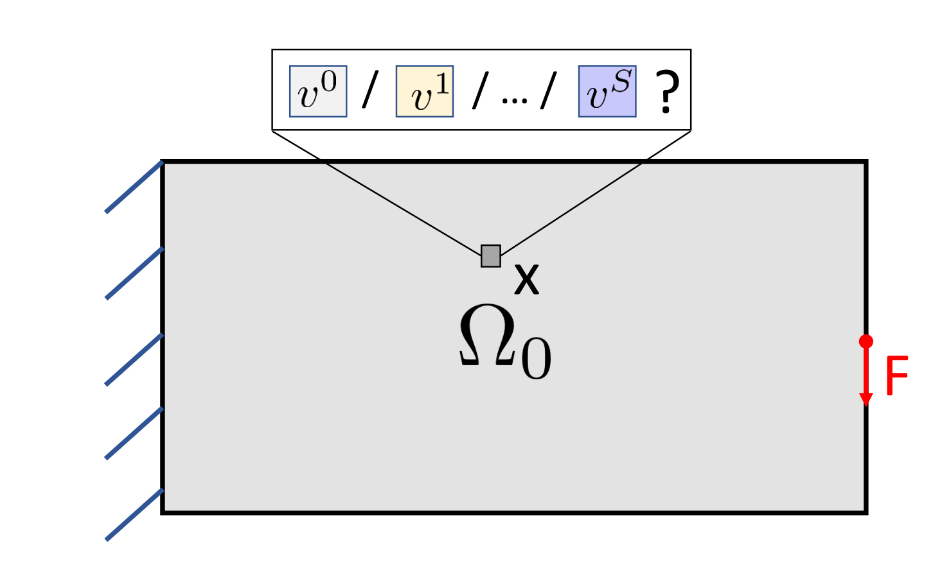
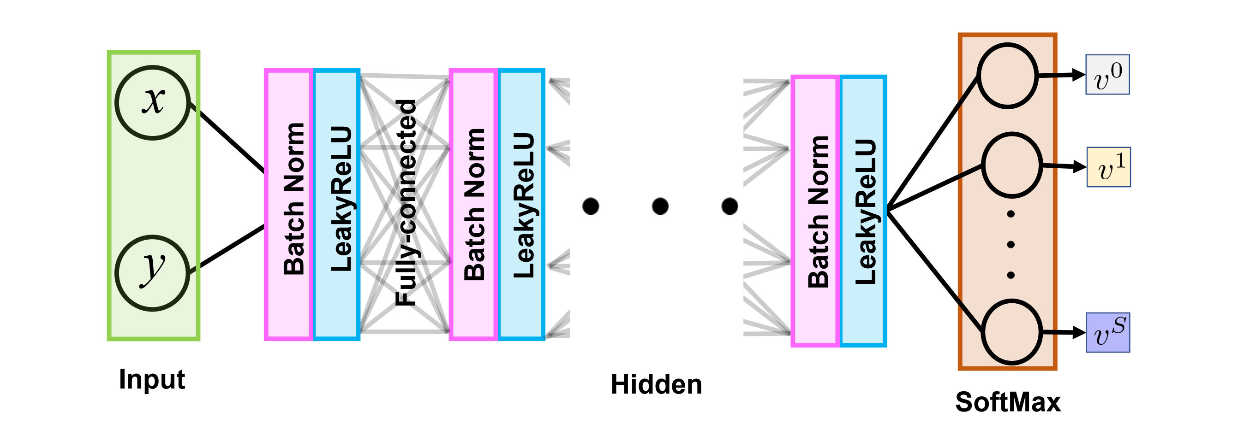
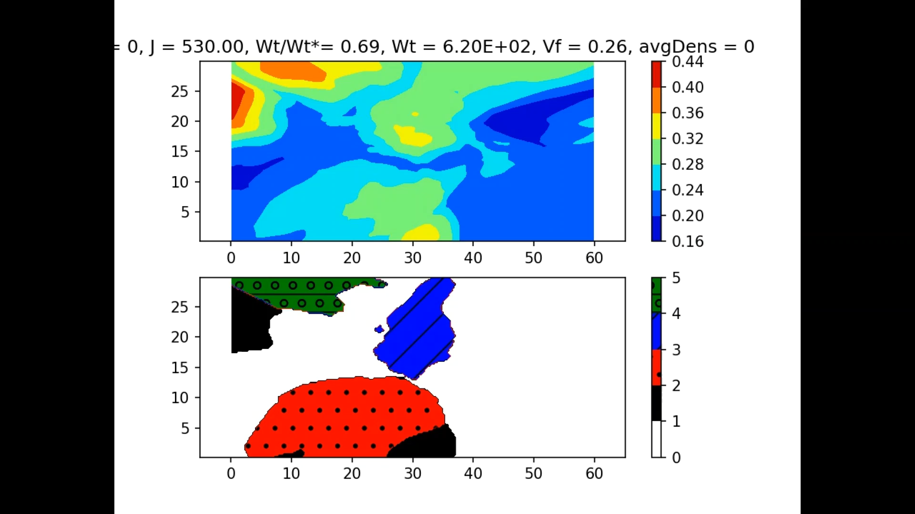
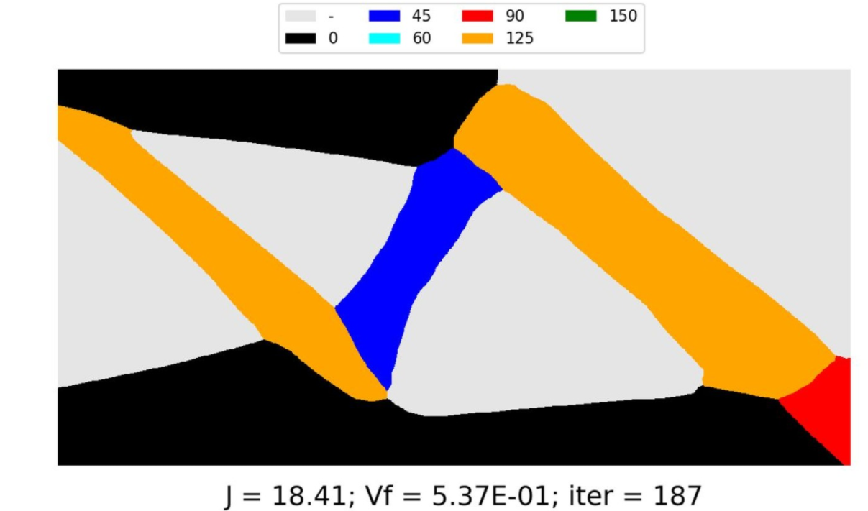
Multi-Material

Slide 18
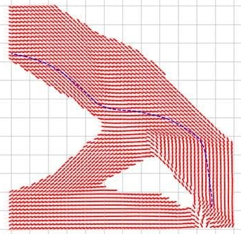

Continuous Fiber Optimization
X
NN
Y

Slide 19
Summary
Used representational capacity of NN to perform TO.
No data as such. Simply used NN for function space.
Competitive to SIMP.
Clean, smooth and differentiable boundary.
Unique advantages to using NN function space.

